Slide 1
Cloud Migration of Enterprise Network
Ozmart Retail Group On-premise to Cloud migration
Simarpreet Kaur (12226696)
Mohmed amaan patel (12204426)
Navdeep Saini (12207773)
Anupa Bodhimaluwa (12216471)
PG-GROUP 8
UNIT: COIT20265
PROJECT MENTOR: BIPLOB RAY

Slide 2
INTRODUCTION
Who is Ozmart ?
Why are we migrating to cloud?
Goals of the presentation

Slide 3
Agile Methodology
What is Agile?
Review
Plan
Design
Develop
Test
Deploy

Slide 4
Why Agile?
It is Faster
Better Communication
Continuous Feedback
Transparency
Flexible

Slide 5
There are Four main Project Phases
Initiation: define project goal, Set target, create project charter, form project team
Planning: create timeline, risk assessment, communication plan, create budget, define roles and responsibilities.
Execution: Building main deliverable, regular progress review, handling issues, perform training
Closing: Hand over final product to customer, intensive support, perform lessons learned, released project team

Slide 6
Infrastructure Overview
Router
Firewall
Switches
WAP
Mobiles
Laptops
PC

Slide 7
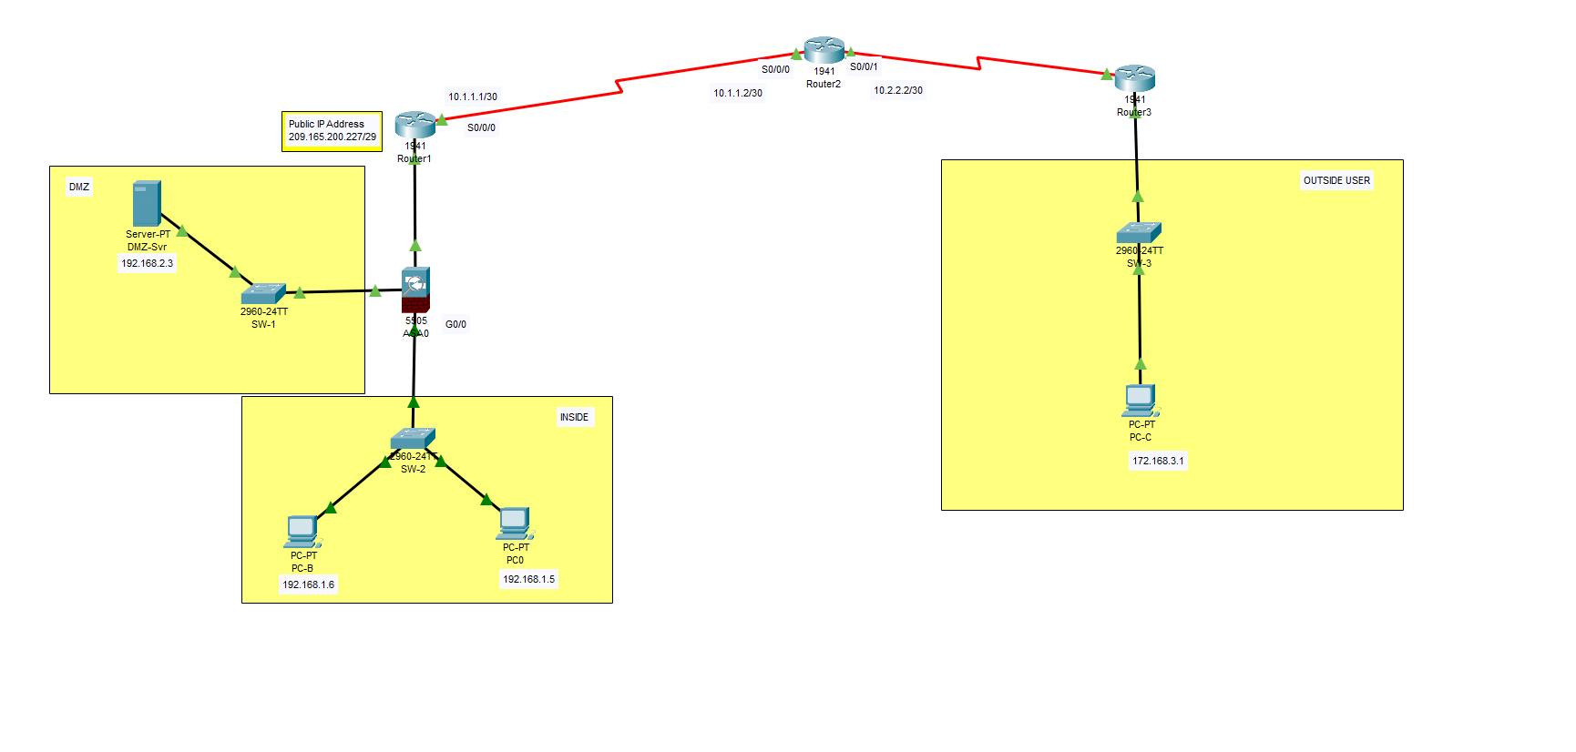
On-premise Network

Slide 8
VMware ESXi Hosts
What is VMware ?
Benefits : Resource efficiency, scalability, and isolation of workloads.
Role in Migration

Slide 9
Security Reason for Moving to Azure
Cloud security
Information protection
Discover and respond
Compliance management
Insider risk management
Information governance
Identify and access management
Threat protection

Slide 10
NIST Framework
RECOVER
IDENTIFY
PROTECT
DETECT
RESPOND
GOVERN

Slide 11
Benefits of the NIST
Help Build Trust Among Partners
Provide comprehensive Guideline
Increases organizational Resilience
Enables integrated risk management approach
Allow flexibility

Slide 12
Azure Portal
Resource group
Virtual network
Virtual gateway
Azure firewall
Azure migration tool

Slide 13
What is cloud Migration?
Moving entire IT infrastructure, including network components, to Azure.
Benefits: Scalability, agility, global reach, and cost efficiency.

Slide 14
Why Migrate our Network To Azure?
Seamless integration with existing systems.
Flexibility to scale as need.
Increased security
Disaster Recovery

Slide 15
Migration Process overview
Assess the On-Premises infrastructure
Hybrid Connectivity
Deploying Network Components
Testing and Optimization

Slide 16
Migration Tools
Azure Migration
Azure Site Recovery
Database Migration Services

Slide 17
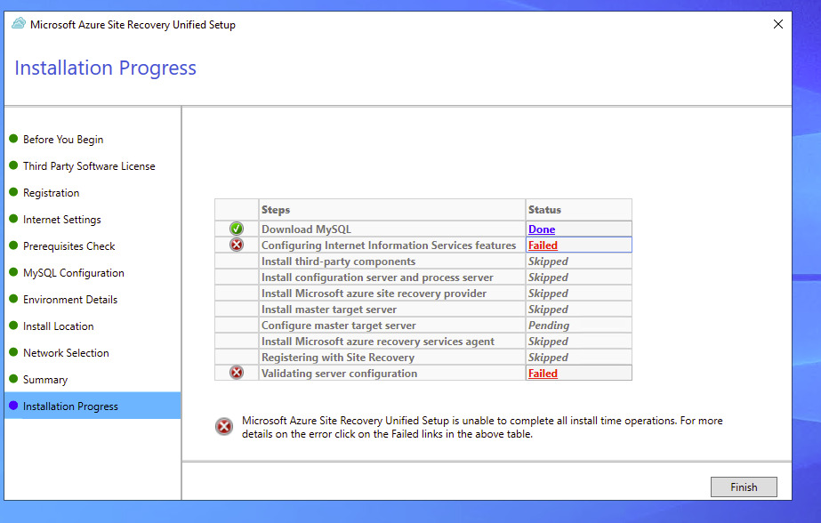
Blockers

Slide 18

THANK YOU

